Slide 1
Open Source Platform and Network Administration
Lesson 26

Slide 3
Learning Objective
Test and gather security reports.

Slide 4
Key Concepts
Security testing tools
Tools to monitor open ports
Security management on physical and virtual systems
Reporting features in common tools

Slide 5
What to Test
Firewalls
Services
Passwords
Access Control

Slide 6
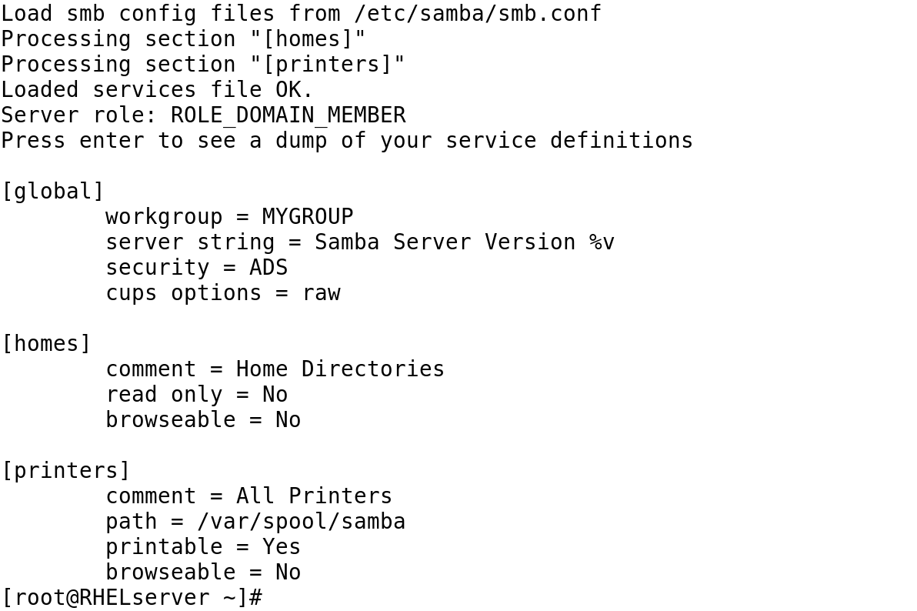
Testing Samba Syntax with testparm

Slide 7
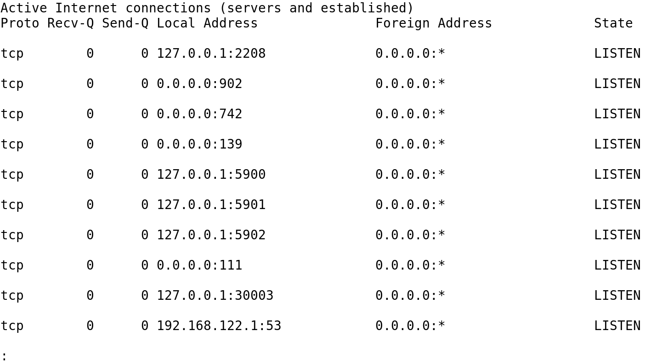
Identify What Your System Listens to with netstat -atun

Slide 8
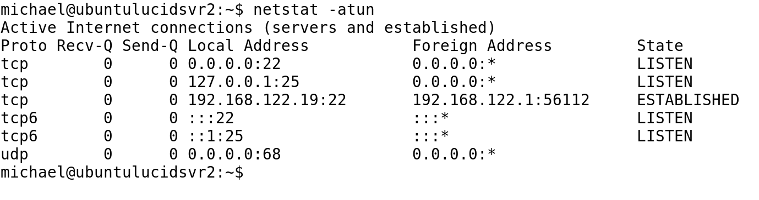
The netstat –atun Command on a Bastion Server

Slide 9
Checking for Open Ports
telnet
netstat
lsof
nmap

Slide 10
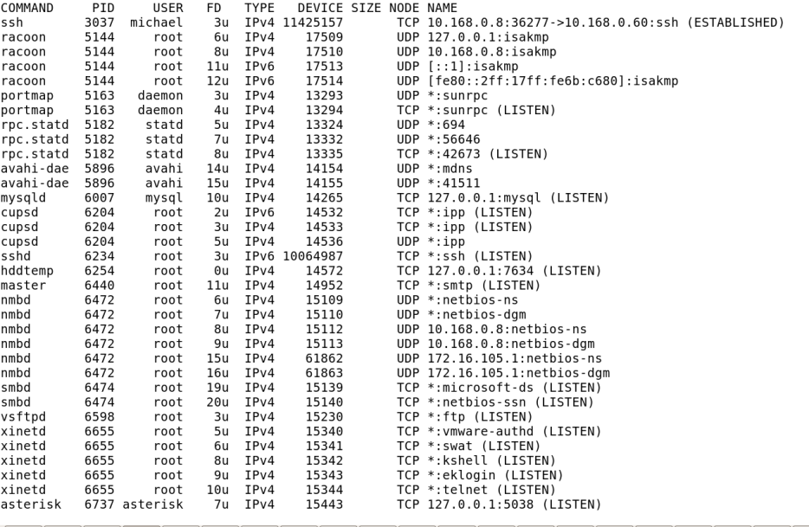
The lsof -ni Command on a Multipurpose System

Slide 11
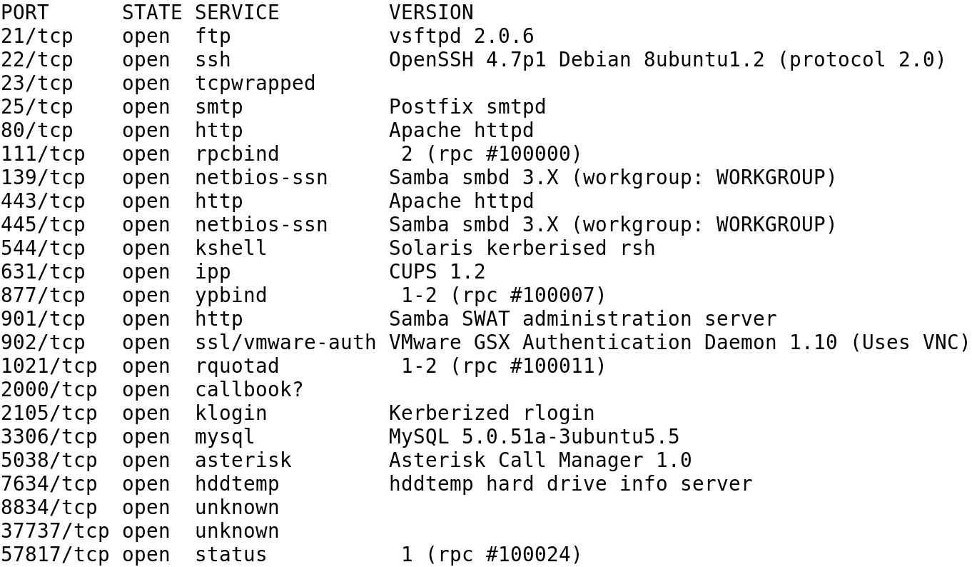
A List of Open Services with Version Information

Slide 12
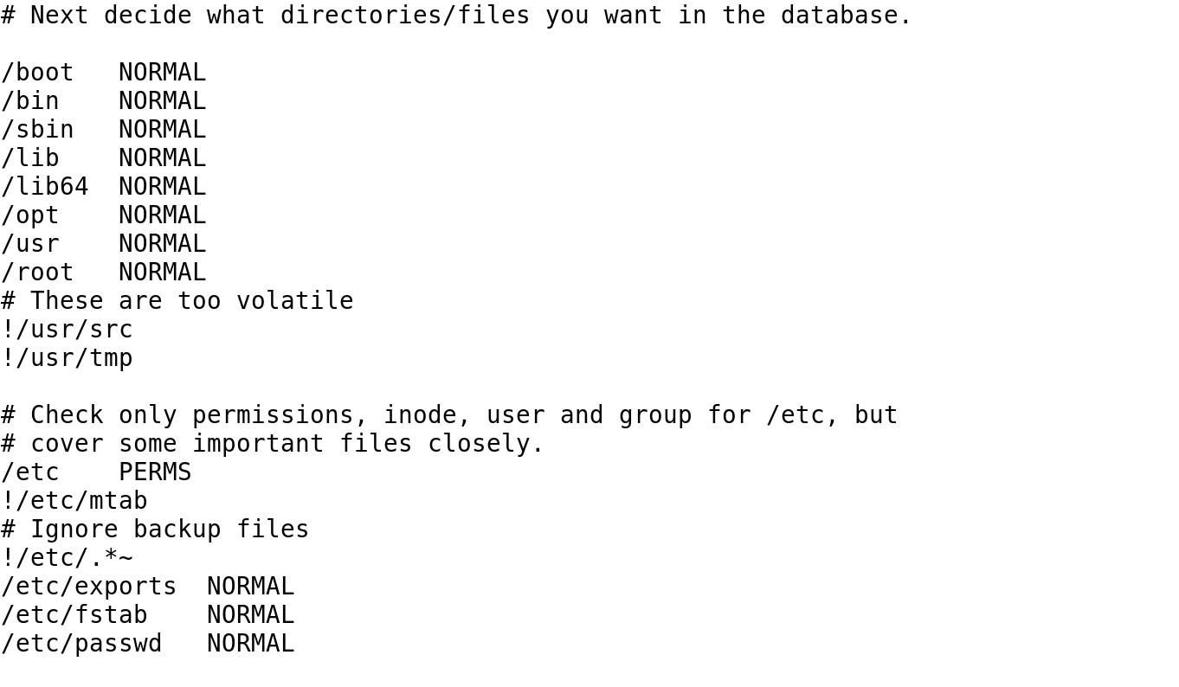
Excerpt from the Default Red Hat Version of aide.conf

